Slide 1
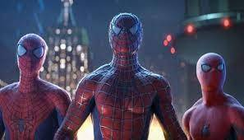
Why Tobey Maguire is the best Spider-man
By Jalen Powell

Slide 2
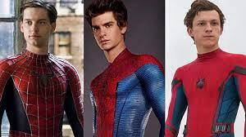
The Three Goats

Slide 4
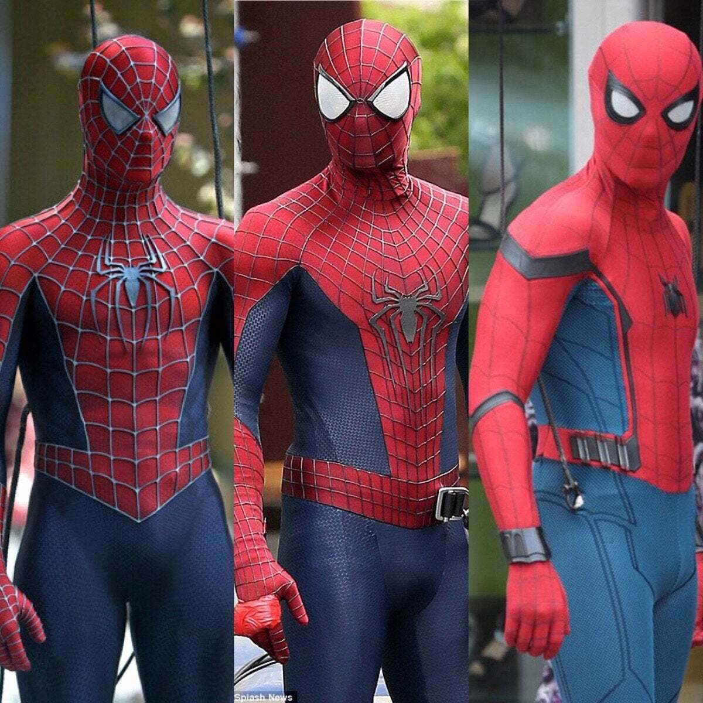
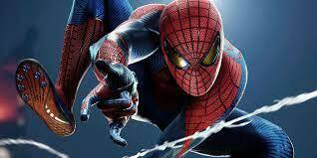
These Are the three suits for each Spiderman

Slide 6
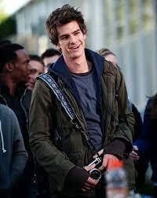
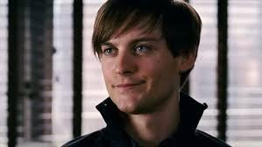
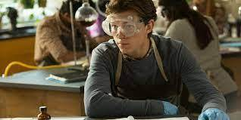
Each actor as Peter Parker in Movie

Slide 8
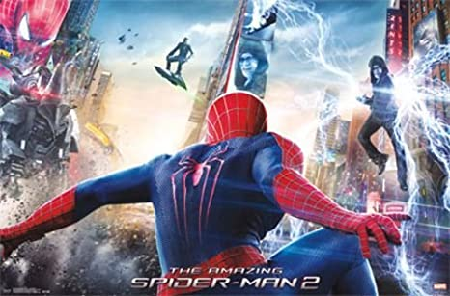
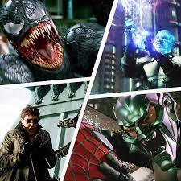
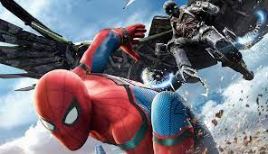
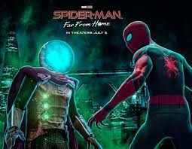
The Villains that Each Spider-man Faced

Slide 10
In Conclusion
Tobey has the best Suit, Tom has a great suit but too much technology, and Andrew has a great suit with amazing camera angles.
Tobey is the best Peter Parker and has the most memorable cast of Peter’s friends, Andrew didn’t have the most fan-desired friends on cast, and Tom has a great cast of Peter’s friends including Mary Jane.
Tobey has the most dangerous villains out of the three with Venom and Sandman on top of the list, Andrew had his handful of villains in the second movie, and Tom has his two villains but a lot are Avenger villains.

